Slide 1
Swedish rural areas: education, development and challenges
Part of the EU project RUral Revival: A Life In The Inspirational Countryside (RURALITIC)
Mikael Börjesson, Felix Bengtsson, André Bryntesson, Pablo Lillo Cea, Henrik Edgren, Laura Giorio, Ida Lidegran & Alexander Kennerley
Higher Education and Research as a Research Object (HERO)
Sociology of Education and Culture (SEC)
Uppsala University
Presentation at Gävle University College, 26 May 2026

Slide 2
Presentation
Project RUral Revival: A Life In The Inspirational Countryside (RURALITIC), 2025–2028 - Mikael
The Swedish part of the project - Mikael
Statistical databases - Laura
Statistical analyses (example of municipalities) - Pablo
Questionary - Felix
Case studies - Mikael

Slide 3
Introduction
Part of RUral Revival: A Life In The Inspirational Countryside (RURALITIC), 2025–2028, directed by Institut national de recherche pour l’agriculture, l’alimentation et l’environnement (INRAE), France, and covering 10 countries and 15 research environments. Funded byEU, Horizon Europe.
France, the Netherlands, Great Britain, Sweden, Denmark, Portugal, Spain, Poland, Austria and Argentina.
Multidisciplinary: sociology, ethnography, economics, history, geography, etc.
Many methods: statistics, econometrics, cartology, observation, surveys, interviews, document analyses, archival studies, conceptual analysis and development.
A total of 9 work packages including conceptual research, history, new classification of rural areas, survey, case studies, mobility studies, database of rural ethnographies, and initiatives to develop rural areas and influence rural policy in Europe.

Slide 4
Transistion processes
Covid and the exodus to the countryside that followed in its wake
De- and reindustrialization
Tourism and ecological industries
Climate change
Digitalization
Demographic changes
In addition,
New security situation and military rearmament and greater focus on preparedness

Slide 5
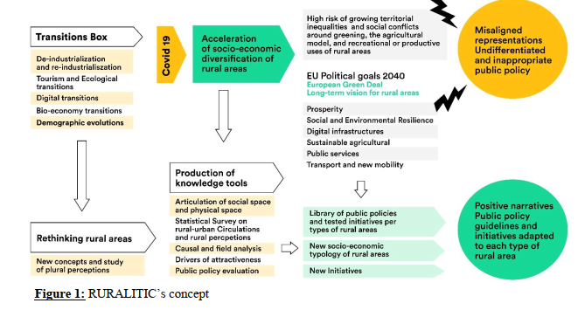
A model

Slide 6
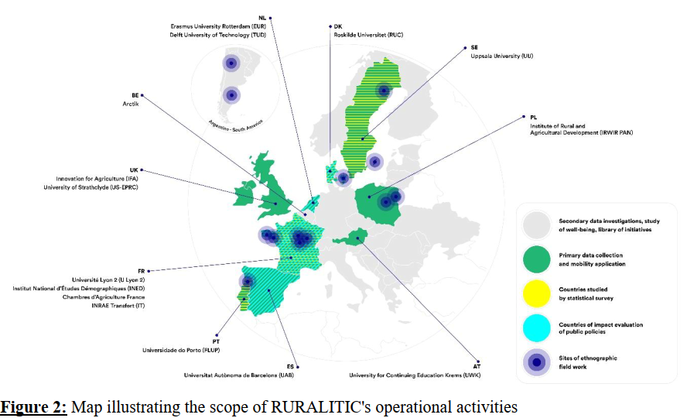
Included countries and case studies

Slide 7
Social spaces at national, regional and local level
A central idea in the project is that social dimensions must be taken more into account in studies of rural areas:
Rural areas are understood as local social spaces in line with Bourdieu's idea of the social space.
Important to understand the relationship between the national, regional and local, which gives different configurations
  Dominant positions in the local, but dominated in the national
  Dominated positions in the local, but dominant in the national
  Doubly dominated locally and nationally
What are general assets? What are more restricted assets? What are the reach of the assets?
Conflict areas and dimensions:
  Permanent and part-time residents
  Established and settlers
  Indigenous peoples and colonizers
  Local, regional, national
  Economic, cultural, environmental, local, security interests
Method: register data in combination with questionnaire, interviews and documents; Geometric data analysis and case studies.

Slide 8
Three analytical levels: physical, social and symbolic
From a Bourdieuan idea of the study of social spaces, three basic analytical levels can be distinguished
A physical, geographical level that includes things such as
  the location of the countryside in the national space, i.e. distance to national centres,
  climate-wise, cultivation zone, vegetation, cultural landscape, etc.
A social, demographic, economic and political dimension that includes
  population density and composition demographic, age, sex, national origin
  Industrial structure, relationship between industry, basic industry and services
  social composition, central groups, local elites, conflicts and collaborations
  economic development, trends, distribution and vulnerability
  education, level and orientation, access to education, specific traditions
  Political
A symbolic, including
  Perceptions of the countryside
  History
  Culture and value systems
  Religion

Slide 9
The perception of the countryside – negative perceptions and images
Depopulation leads to reduced economic viability, which in turn results in poorer services, healthcare, education, etc., which leads to a further reduction in the population.
Poorer health, more unemployment, greater social problems, poverty, social misery, etc.
Politically stigmatized, lower level of voters, larger proportions who vote for parties of discontent, lower trust in authorities, politicians, science, etc.
Low level of education, lower grades, lower transition to higher education, poorer access to education
Low participation in cultural activities, poorer range of culture.

Slide 10
The perception of the countryside – positive perceptions and images
Access to nature and important natural resources that are crucial for climate change, sun, wind and water, minerals, forests.
A slower pace and simpler life.
Greater degree of meaningfulness, strong connection to the local, closeness to family and friends.
More ecologically sustainable, greater degree of self-sufficiency, lower consumption.
Digitalisation opens up access to work, culture, entertainment, contexts that are not limited by geographical distances.
In terms of security (military as well as preparedness) requires investments in infrastructure, roads, bridges, facilities, but also in production, supply chains, animal husbandry, cultivation, etc.

Slide 11
Mobility and circulation, and its importance for the place
Another central starting point in the project is that the countryside is not static but dynamic and that there is a flow of people to and from the place.
Is it important to study how people move geographically over time, what places do you live and spend time in?
How do you change the place by the flow of people, who disappears, who is added, who returns?
Epistemological Consistency: Overcoming Divisions That
  Urban Sociology and Rural Sociology
  Urban and rural history
  Etc regarding geography, economy, culture, etc.
A historicizing social science is needed for the study of space.

Slide 12
The Swedish contribution
National, regional and local analyses of social spaces based on register data
Survey study of 10 areas
Case studies of two regions, Västerbotten and Gotland
Historical study of the construction of rural areas

Slide 13
The overlooked importance of education
Very little about education in the project, we intend to study
The importance of access to education (especially preschools and primary schools) for the attractiveness of the local place
The availability of secondary and higher education in the region and its content and orientation in the light of regional and local needs
The distribution of educational capital in the geographical space
The importance of distance learning

Slide 14
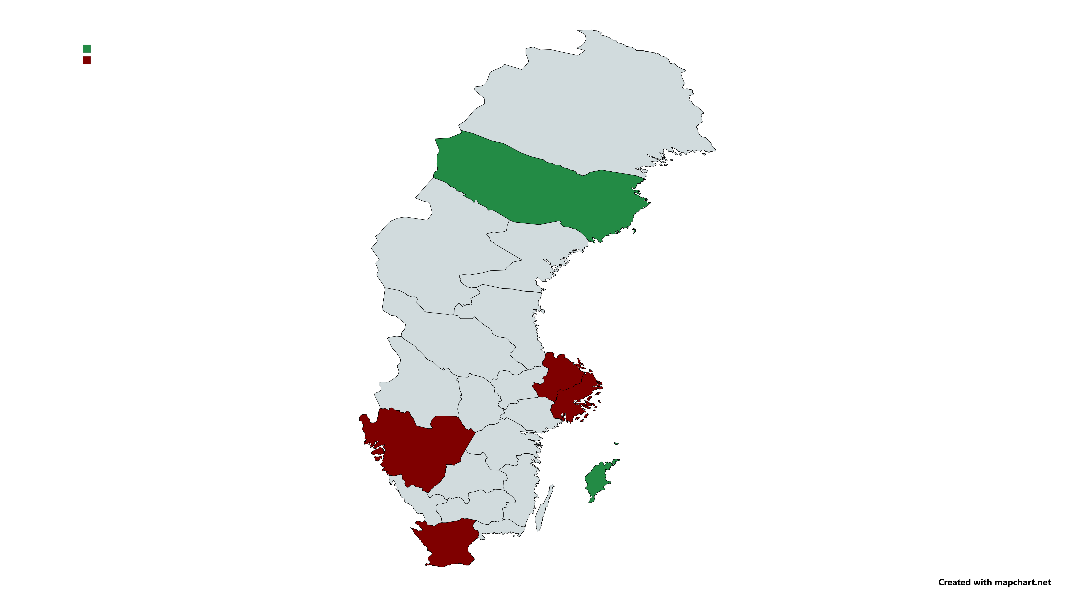
Case description
Västerbotten:
In the north, stable population, slowly increasing, especially the Coast and especially the cities of Umeå (university) and Skellefteå (Northvolt) have grown, while the rural areas are decreasing.
Forestry, industry production, mining (metals), water power plants, services the largest sector of employment, 3/4, municipalities, universities and hospitals.
Gotland:
An island in the Baltic Sea.
Seasonal tourism, farming, mining (limestone quarries), public services.
Military importance is increasing.
Small companies.
Historically a very important place, a crucial commercial site
in the Middle Ages.
Insert map here if you have one
Västerbotten region
Stockholm/Uppsala
Gothenburg
Gotland region
Skåne

Slide 15
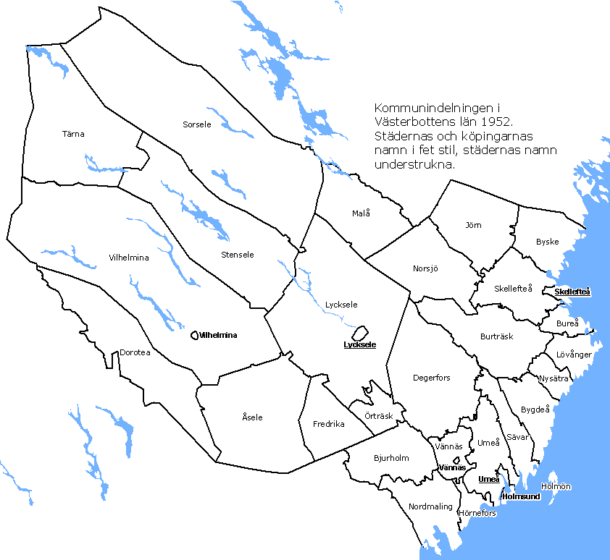
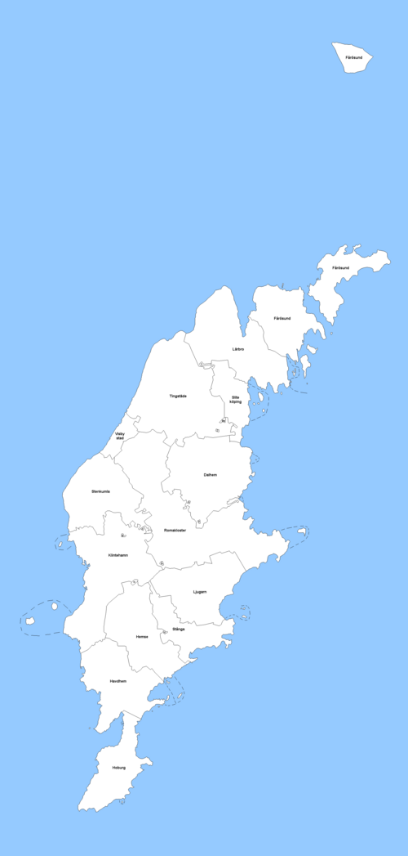
Regional divisions and classifications
Gotland:
3 183,7 km²
60 971 inhabitants
19,2 inhabitants per km²
1 municipality
60 971 inhabitants per municipality
93 districts (church areas)
Västerbotten:
55 432 km²
279 028 inhabitants
5,0 inhabitants per km²
15 municipalities
18 201 inhabitants per municipalities
53 districts (church areas)

Slide 16

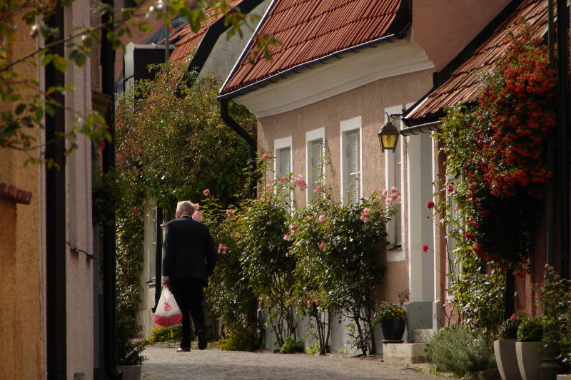
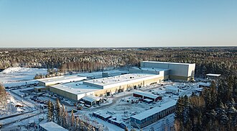
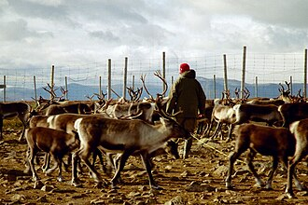
Conflicts and tensions
Gotland:
Security and defense interests.
Central (Visby) and rural (rest of the island).
Tourists versus inhabitants.
Gentrification and rising house and land prices.
Services, especially health and education, hollowed out.
Water and power supply critical.
Västerbotten:
Central (coast) and rural (inland), expansion and contraction,
Indigenous groups (Sami) versus the state and commercial interests.
Climate change and infrastructure demand. Pressures on national resources, mining, water power, wind power. Push for new sustainable industries (batteries, steel). Leads to tensions between the state, the regions, the municipalities, and the companies.
Skellefteå: Re-industrialization. Increasing tensions after Northvolt’s bankruptcy and foreign acquisition.
Services, especially health and education, hollowed out in the less populated areas.
Both cases characterized by conflicts between global/national strategies and local social capacity.

Slide 17
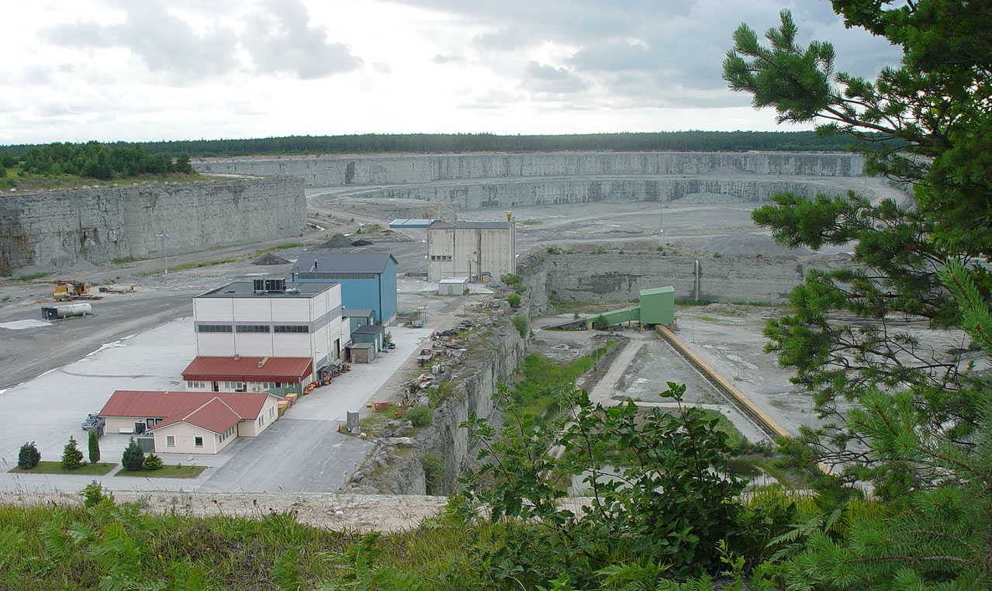
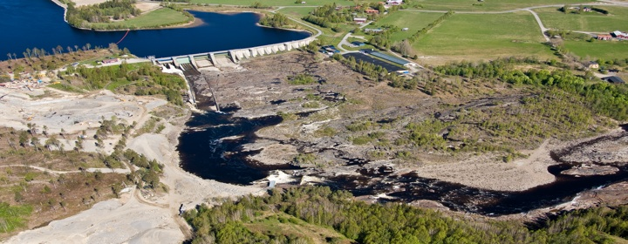
Description of work
Fieldwork not yet initiated – currently in preparatory phase.
Focus on survey study (WP4) and register data acquisition (start delivery in November 2025), will inform field work.
Preliminary mapping of DeSO areas in Västerbotten and Gotland completed to outline local dynamics.
Started assembling literature on the two cases and began reading.

Slide 18
Building a data-driven urban-rural typology
Preliminary results

Slide 19
Data & Motivation
Sweden's 290 municipalities are routinely classified by administrative or population-size rules (SCB). These categories are imposed from outside the data.
This analysis builds a typology from the data itself: How do municipalities differ across {six} dimensions?
Data source: Statistics Sweden, 2022 sampling.
Method: Correspondence Analysis + Agglomerative Hierarchical Clustering
Key pre-processing: block normalisation. Within each block, every municipality is rescaled to the same total. This prevents Stockholm, Göteborg and Malmö from dominating the analysis simply because they are large.
Six ACTIVE variable blocks:
  Education (4 attainment levels)
  Employment (16 activity sectors)
  Housing (rented / tenant-owned / owner-occupied)
  Workplace mobility (commuters in, out, working locally)
  Migration (in- and outmigration)
  Demography (retirees, number of localities)
Two SUPPLEMENTARY blocks projected post-hoc:
  Educational provision (pre-school through HE, by ownership)
  Opinion (survey satisfaction with local schools)

Slide 20
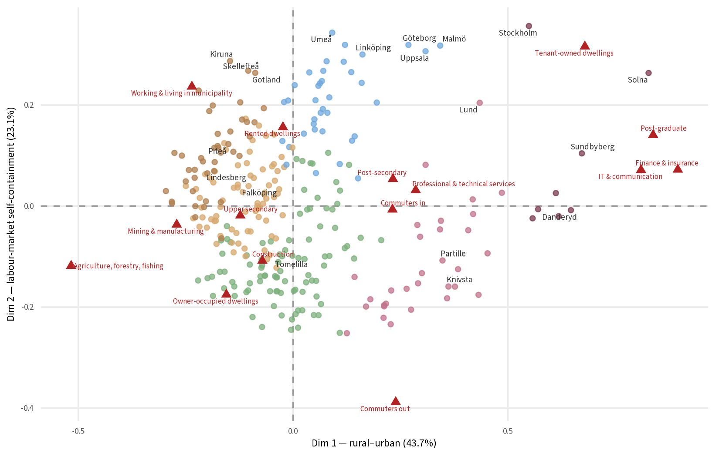

Slide 21
Dim 1 (rural–urban):
  Left pole → agriculture, mining & manufacturing, owner-occupied housing, upper-secondary education.
  Right pole → IT, finance, professional services, post-graduate attainment, apartment housing.
Dim 2 (labour-market self-containment):
  Top → residents work where they live (Göteborg, Malmö, Umeå).
  Bottom → outbound commuters, residential satellites (Knivsta, Salem, Staffanstorp).
Together Dim 1 + Dim 2 account for ~65% of total variability.

Slide 22
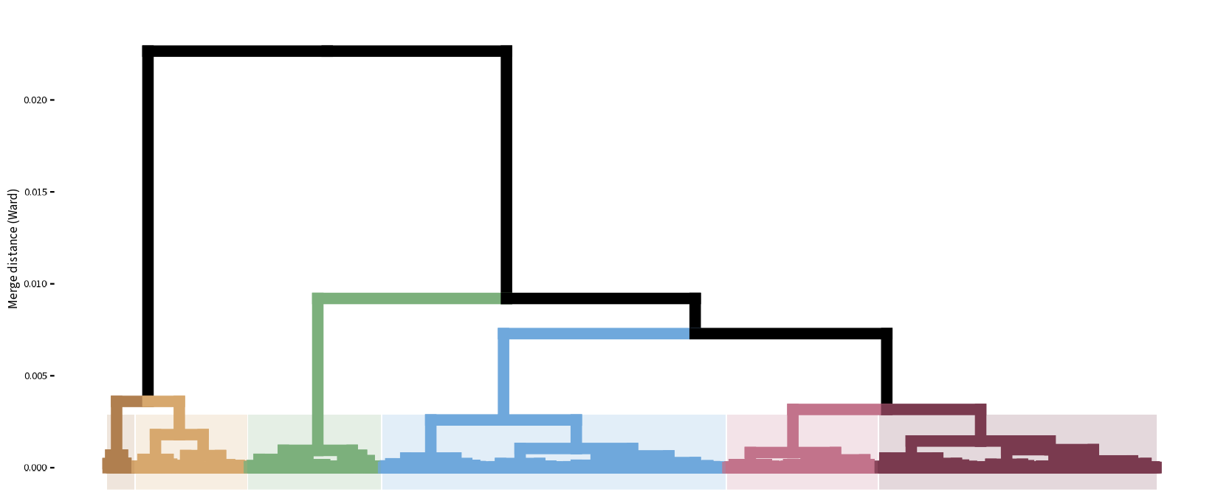

Slide 23
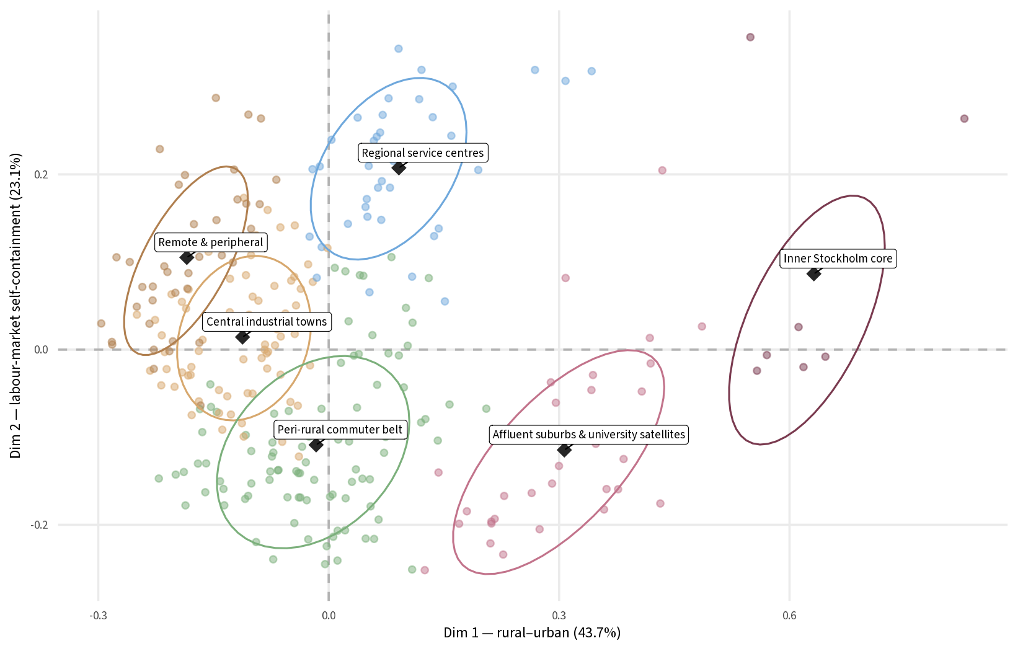

Slide 24
Cluster Description
Cl 1: Remote & peripheral
Most rural extreme. Agriculture/forestry/fishing, sparsely populated, own full educational infrastructure at every age (komvux, preschool). Examples: Kiruna, Piteå, Skellefteå, Gotland.
Cl 2: Central industrial towns
Rural-industrial, but not as remote. Mining & manufacturing dominant. Owner-occupied housing, upper-secondary ceiling. Examples: Falköping, Lindesberg, Hedemora.
Cl 3: Peri-rural commuter belt
Small southern and central rural municipalities. Many residents commute out. Owner-occupied, construction and agriculture visible. Below-average satisfaction with local high schools. Examples: Tomelilla, Osby, Klippan, Sölvesborg.
Cl 4: Regional service centres
Mid-sized cities with self-contained labour markets. Rented and tenant-owned housing, public administration, post-secondary attainment. Examples: Göteborg, Malmö, Umeå, Linköping, Kalmar.
Cl 5: Affluent suburbs & university satellites
Outbound commuters, post-secondary attainment, tenant-owned housing. Residential satellites whose labour markets sit elsewhere. Examples: Lund, Mölndal, Partille, Huddinge, Knivsta, Kungsbacka.
Cl 6: Inner Stockholm core
Inbound commuting, IT and finance employment, apartment housing, post-graduate attainment at extreme levels. These are destinationsin the commuting network, not origins. Examples: Stockholm, Solna, Sundbyberg, Danderyd, Lidingö, Täby.

Slide 25
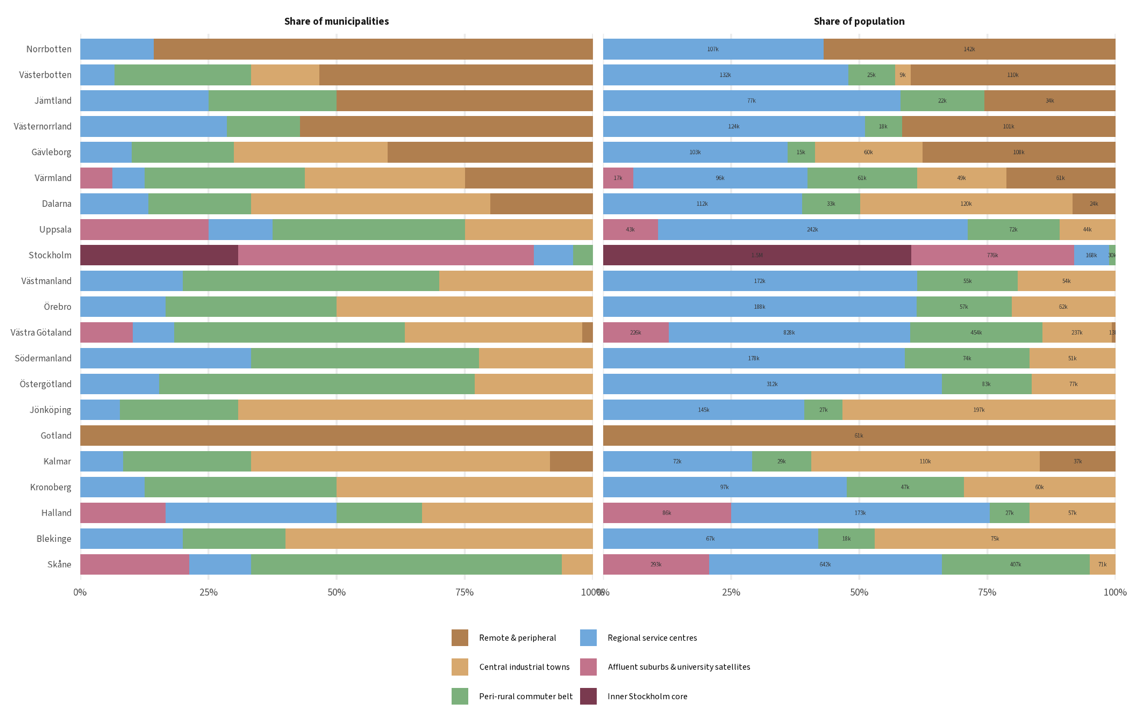

Slide 26
Preliminary Conclusions
"Rural" is not one thing. The data split rural Sweden into three distinct types: remote & peripheral, central industrial, and peri-rural commuter, each with a different relationship to employment, housing and services.
The biggest break is within rural, not between rural and urban. What separates cluster 1 & 2 from cluster 3 is not size but labour-market self-containment: industrial and peripheral municipalities retain their workforce locally, peri-rural ones do not.
Whether a municipality is self-contained or export-dependent (in labour-market terms) cuts across the urban–rural gradient and drives cluster membership independently.
"Urban" also splits in two. Regional service centres (Cl. 4) and the metropolitan region (Cl. 5 & 6) are both urban but structurally different — one is self-contained, the other is organised around a commuting hierarchy.
Within the metropolitan region, origins and destinations are distinct. Affluent suburbs send workers to the core; the inner Stockholm cluster receives them. The standard "Stockholm region" label conflates two opposite positions in the commuting network.

Slide 28


